Slide 1

DATA VISUALIZATION
Assignment 5
By
Deepthi Nakeri

Slide 2
Step 1
Analyze the meaning of data using the definition of fields present in website
https://earthquake.usgs.gov/earthquakes/feed/

Slide 3
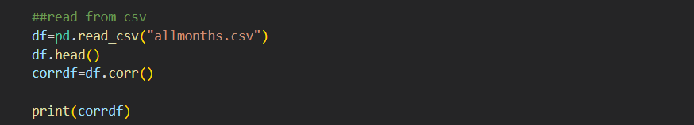
Step 2
Created the correlation matrix between fields of dataset

Slide 4

Step 3
Extracted Column labels and row labels from the correlation matrix

Slide 5
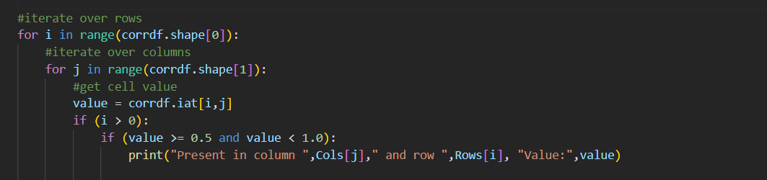
Step 4
Looped through correlation matrix and identified cells with higher level of correlation

Slide 6
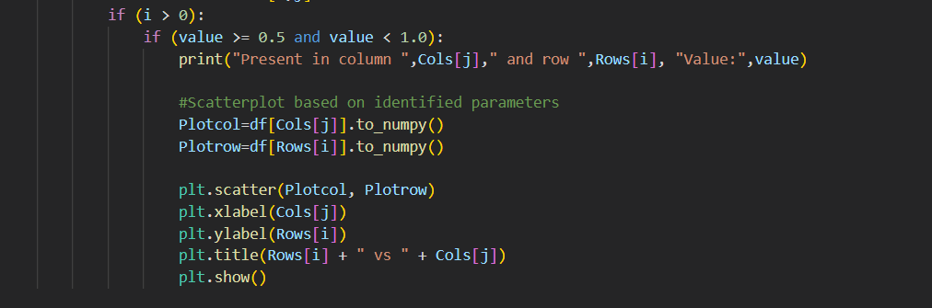
Step 5
Within the loop called the scatter plot function to generate the chart.
Notes:
Plotcol and plotrow contains the list of values for the given parameters.It is passed to scatterplot as xaxis and yaxis

Slide 7

About the Code
Code will dynamically generate the chart based on the correlation identified.
There is no need to hard code column headers.
The code will work for any number of labelled columns/any other data set

Slide 8

Analysis of output
Many charts will be created using the correlation coefficient. However we have to apply domain knowledge and understanding of the fields to narrow down to useful information.

Slide 9
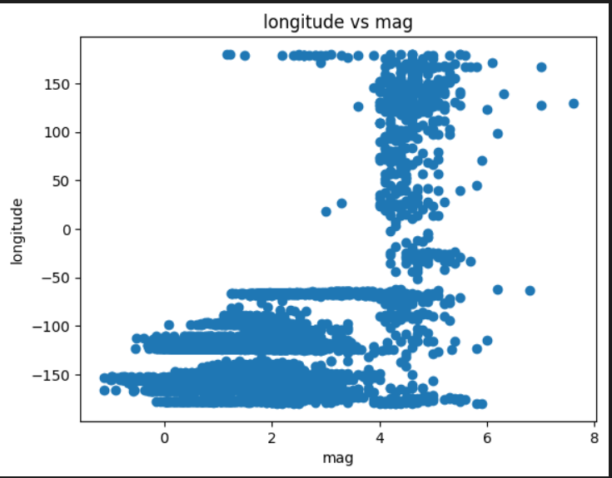
Longitude vs Magnitude
There seems to be some correlation between magnitude and latitude, longitude
Most of the earthquakes with magnitude 0 to 4 are happening between longitude 100 to 150.
Earthquakes with magnitudes 4 to 6 occur evenly across all longitudes.

Slide 10
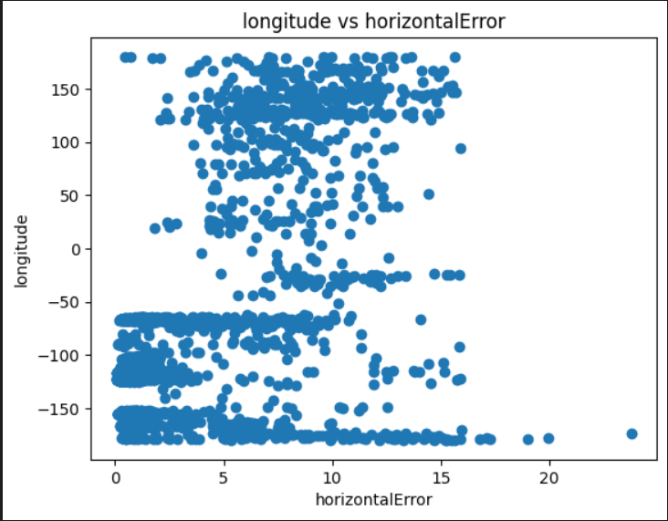
Longitude vs Horizontal Error
There is no specific correlation between longitude and horizontal error

Slide 11
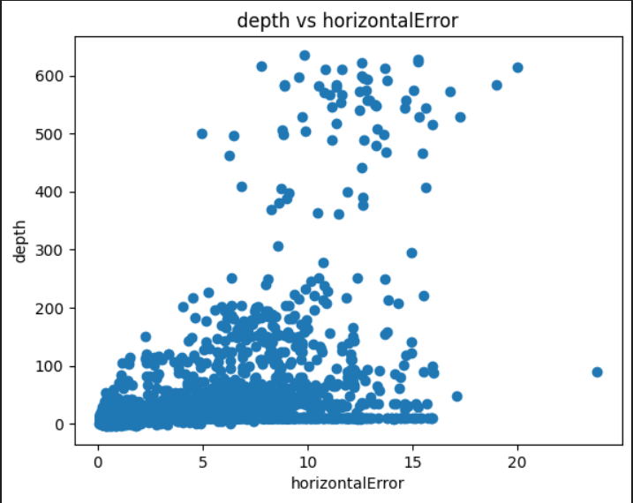
Depth vs Horizontal Error
Most of the horizontal errors observed for depth between 0 to 100 kms.
This could also mean most of the earthquakes are happening within a depth of 100 kms.

Slide 12
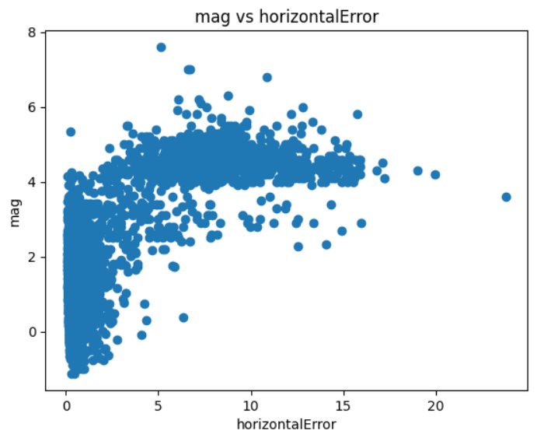
Magnitude vs Horizontal Error
Most of the earthquakes with magnitudes 0 to 4 has horizontal error less than 5 kms
Most of the earthquakes with magnitude 4 to 6 have higher horizontal error.
When the magnitude increases the shaking increases ,and when it happens the measurement can be impacted causing higher horizontal error.

Slide 13
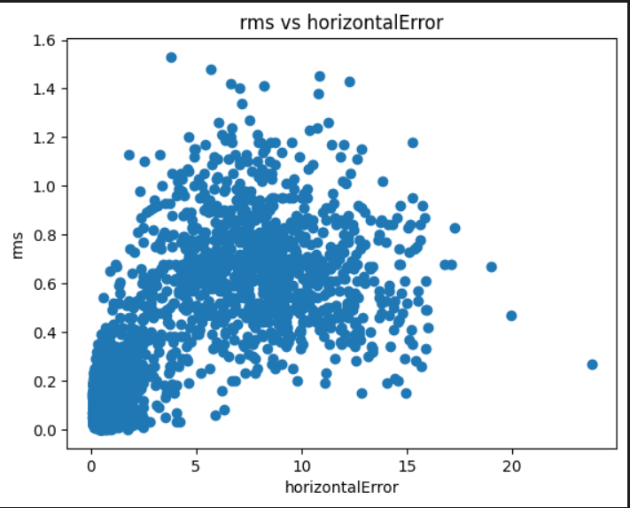
RMS vs Horizontal Error
Most of the horizontal errors from 0 to 5 km have rms of 0 to 0.4
Most of the horizontal errors from 5 to 15 kms are within rms range 0.6 to 1.
This means whatever earthquakes we can predict easily have a horizontal error within 5 km.

Slide 14
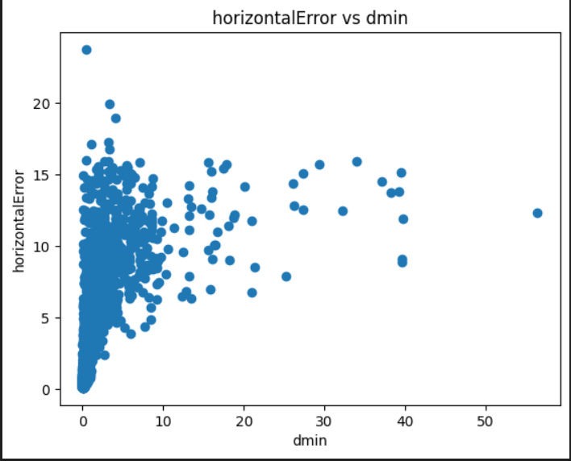
Horizontal Error vs Dmin
While most of the horizontal errors are spanning between dmin of 0 to 10 degrees, it does not give any specific information or correlation between these two parameters.

